Slide 1
Wireless Transmission Technology and Systems

Slide 2
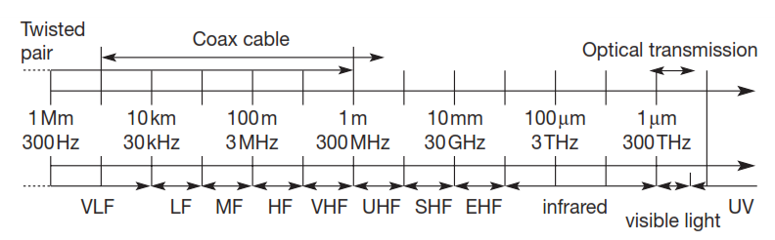
Frequency Spectrum

Slide 3
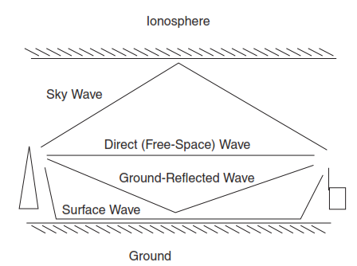
Radio Propagation Modes

Slide 4
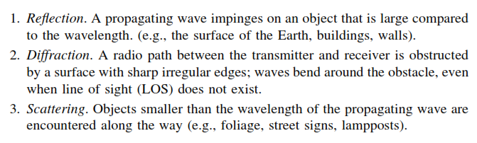
Basic Propagation Impairments

Slide 5
Multipath Types
Specular Multipath
Diffused Multipath
Fade Factors
Large Scale Fade
Small Scale Fade

Slide 6
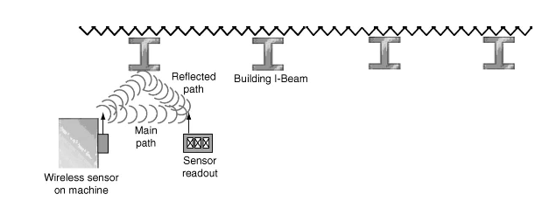
Sample Indoor Interference

Slide 7

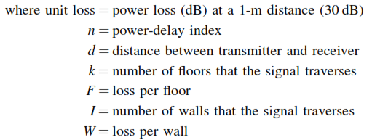
Path Loss

Slide 8
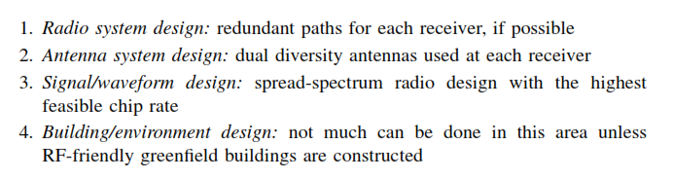
Multipath Mitigation Techniques

Slide 9

Digital Modulation Techniques
Amplitude Shift Keying
Frequency Shift Keying
Phase Shift Keying
Quadrature Amplitude Modulation
Shannon’s Equation
C- Capacity of single Carrier with bandwidth W
S/N Signal to Noise Ration

Slide 10
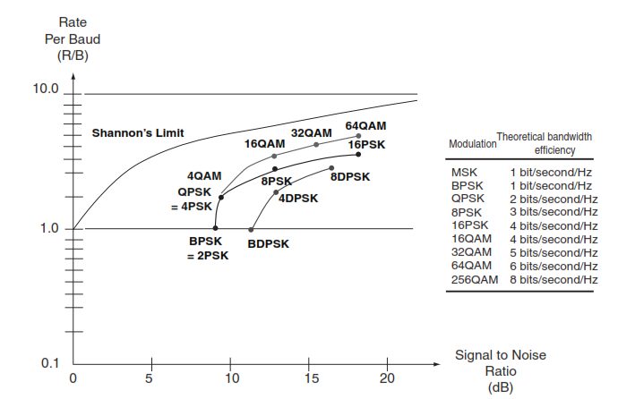
Efficiency of Modulation Schemes

Slide 11
Spread Spectrum Modulation
Direct Sequence Spread Spectrum (DSSS)
Frequency Hopping Spread Spectrum (FHSS)

Slide 12
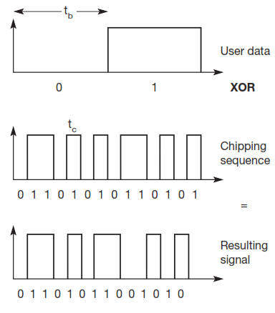
DSSS

Slide 13
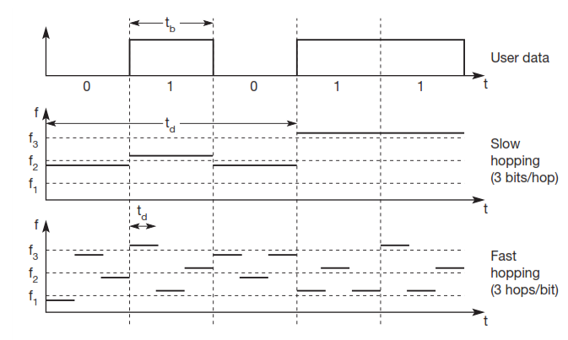
FHSS

Slide 14
Comparison between DSSS and FHSS
DSSS | FHSS
High Complexity Sender & Receiver Circuits | Low Complexity Sender and Receiver circuits
Complex Synchronization mechanism required | Less complex Synchronization mechanism
High Security; Detection of signal not possible | Less Security
High throughput | Low throughput
Multipath mitigation can be achieved through Rake Receivers | Improved multipath mitigation
Low power for transmission | Higher Power for transmission
Used in WLAN and WSN | Used in Bluetooth

Slide 15
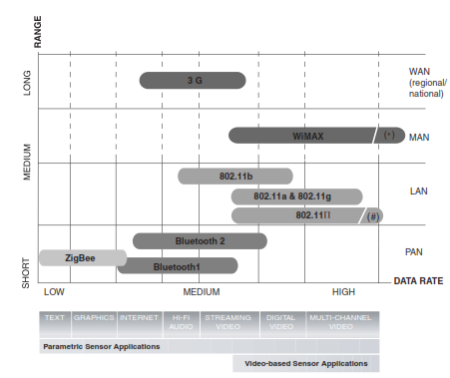
AVAILABLE WIRELESS TECHNOLOGIES

Slide 16
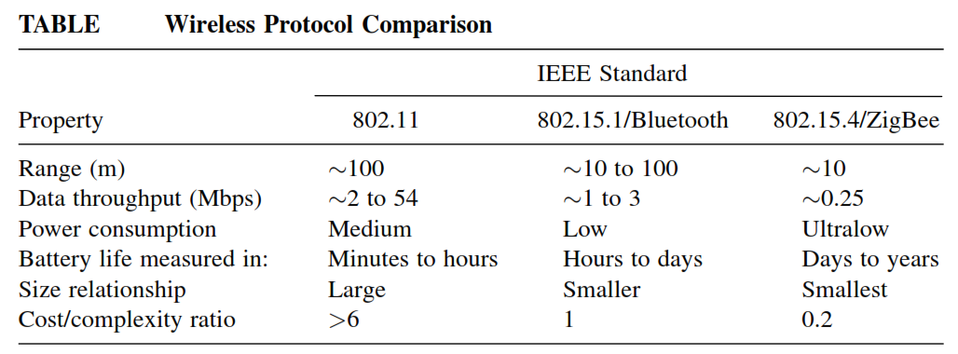

Slide 17
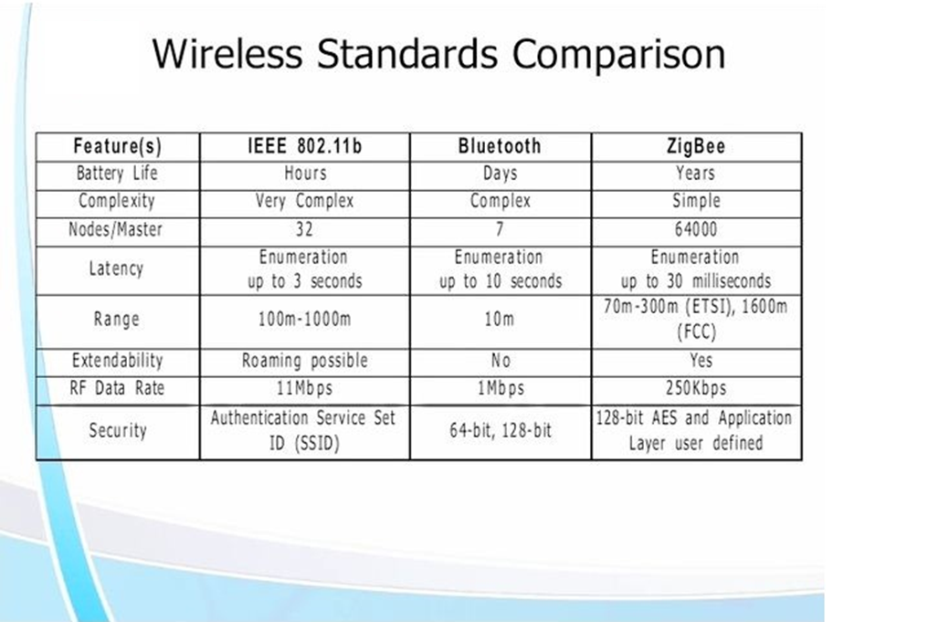

Slide 18
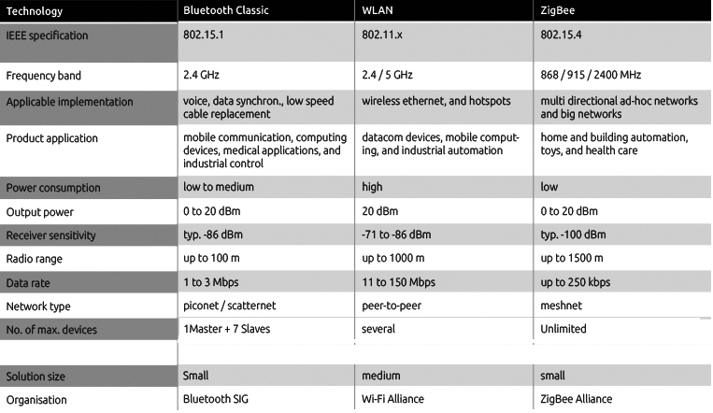

Slide 19
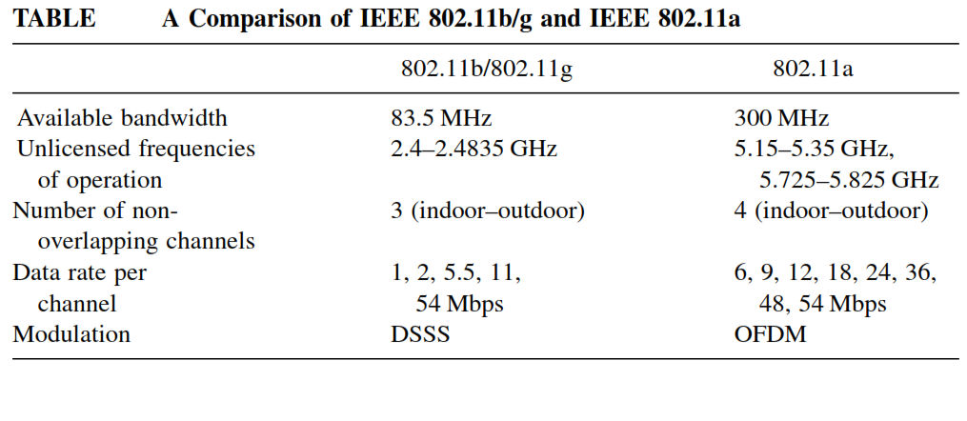

Slide 20
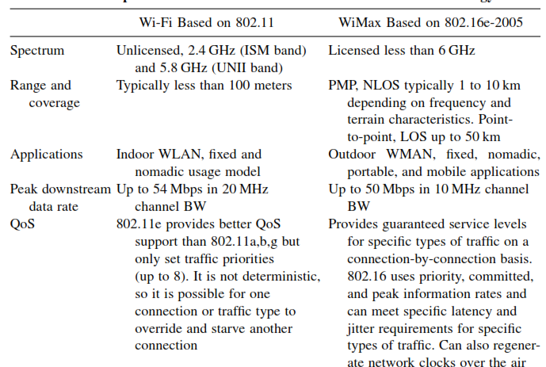

Slide 21
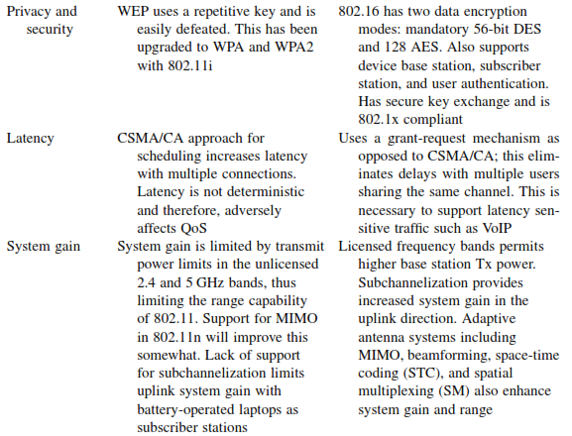

Slide 22
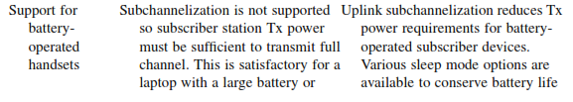

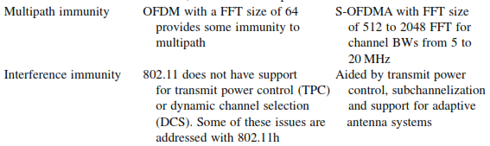

Slide 23
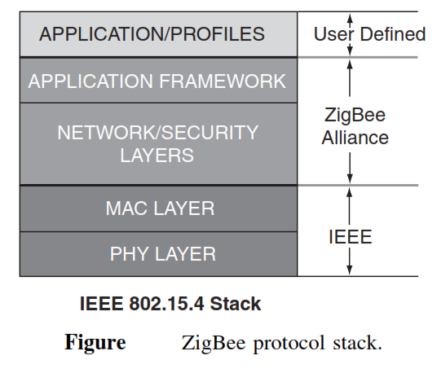

Slide 24
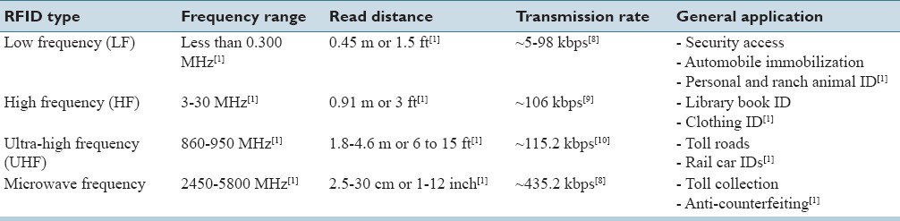

Slide 25
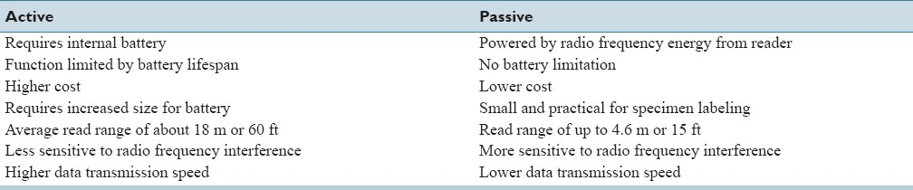
Comparison of Active and Passive Tags

Slide 26
